Slide 1



A56 FindingSRAM
GAN CHIP — Deep Learning Accelerator (DLA) Engine
Schematic Review Video: https://drive.google.com/file/d/1JfOFYj1lsYQqmhWTVg9je3te7nSkuVEE/view?usp=drive_link
Discord name | Affiliation | Experience | Role
mpa216 | Bandung Insittute of Technology | Undergraduate | Team lead
fairuz0722 | Bandung Insittute of Technology | Undergraduate | Circuit Design and Layout
Track A · Open-source ASIC · GF180MCU 180 nm · OpenLane / LibreLane

Slide 2
Results - Signoff Table
Check | Tool | Result
DRC (full) | Magic | 0 violations COUNT: 0, illegal‑overlap 0
DRC (routing) | OpenROAD DRT | 0
Antenna | OpenROAD | 0 nets / 0 pins closed via GRT diode margin 25→75
LVS | Netgen | Circuits match uniquely 25,342 devices / 14,058 nets, 0 errors
GDS XOR | Magic ⟷ KLayout | 0 differences
Setup | OpenSTA · 9 corners | MET - worst +14.98 ns @ max_ss_125C_3v00 · 0 vios
Hold | OpenSTA · 9 corners | MET - worst +0.117 ns @ min_ff_n40C_3v60 · 0 vios

Slide 3
Results - 9 Corner Timing
Corner | Setup WS (ns) | Hold WS (ns) | Setup vio | Hold vio
min_tt_025C_3v30 | 24.778 | 0.2135 | 0 | 0
nom_tt_025C_3v30 | 24.501 | 0.2144 | 0 | 0
max_tt_025C_3v30 | 24.178 | 0.2155 | 0 | 0
min_ss_125C_3v00 | 15.693 | 0.3648 | 0 | 0
nom_ss_125C_3v00 | 15.364 | 0.3660 | 0 | 0
max_ss_125C_3v00 ◄ worst setup | 14.980 | 0.3674 | 0 | 0
min_ff_n40C_3v60 ◄ worst hold | 29.283 | 0.1167 | 0 | 0
nom_ff_n40C_3v60 | 29.055 | 0.1174 | 0 | 0
max_ff_n40C_3v60 | 28.794 | 0.1182 | 0 | 0

Slide 4
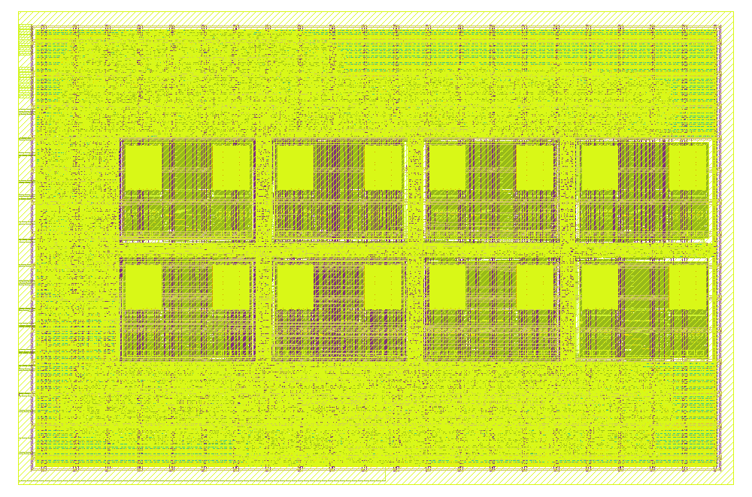
Layout Render - Klayout
KLayout — GDS view. The streamed‑out dla_engine_chip.gds (fill + every metal). Eight SRAM macros in a 4×2 cluster (shifted +130 µm east to open a west I/O channel); the yellow sea is std‑cell logic + fill. DRC‑clean, LVS‑verified, antenna 0.
Floorplan at a glance.
A buffer (weights, row broadcast) → bottom row, 4 macros
B buffer (inputs, column broadcast) → top row, 4 macros
C buffer (results) → flip‑flops in the fabric — no macro
Clustered 4×2 block (55 µm channels), shifted +130 µm east + perimeter logic/fill

Slide 5
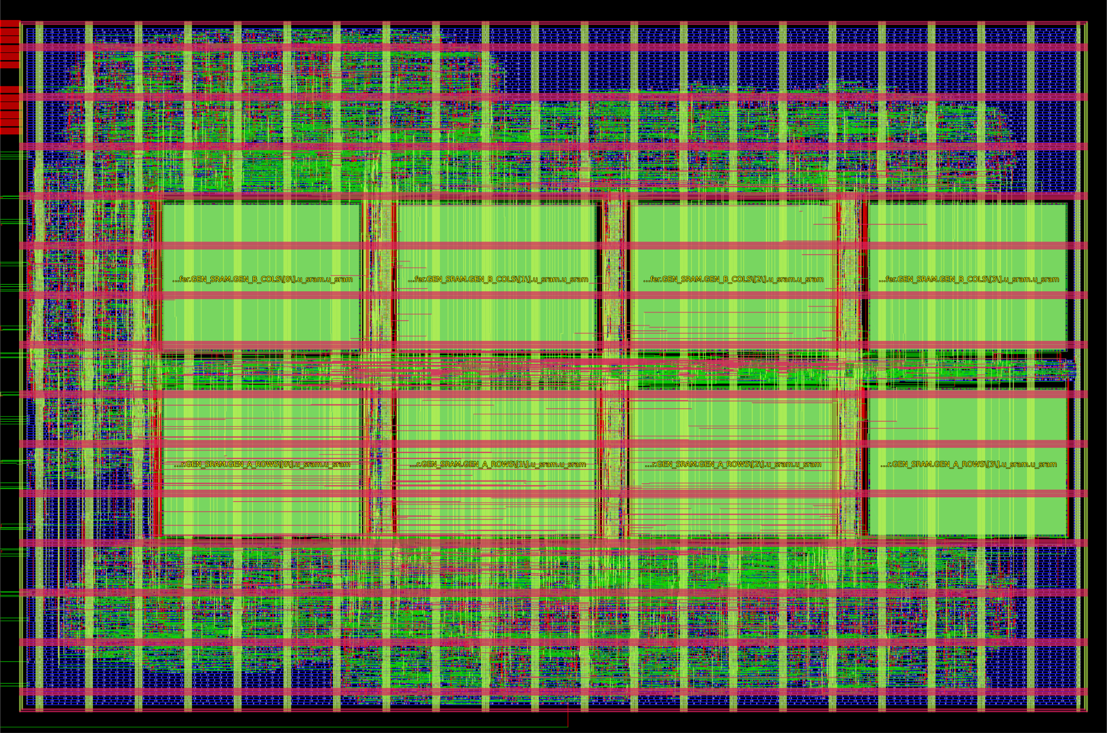
Layout Render - Openroad
OpenROAD — design view. Same die from the P&R database. Macros under u_dla.u_a_buffer / u_dla.u_b_buffer (top = B, bottom = A), pulled together so the SRAM→PE broadcast nets stay short; green diamonds are the boundary pins.
Signoff metrics
Clock | 25 MHz / 40 ns
Antenna | 0 / 0
DRC / LVS | 0 / match
Timing (9 corners) | met
Utilization | 53.9 %
Total power (tt) | 125 mW
Instances | 83,862

Slide 6
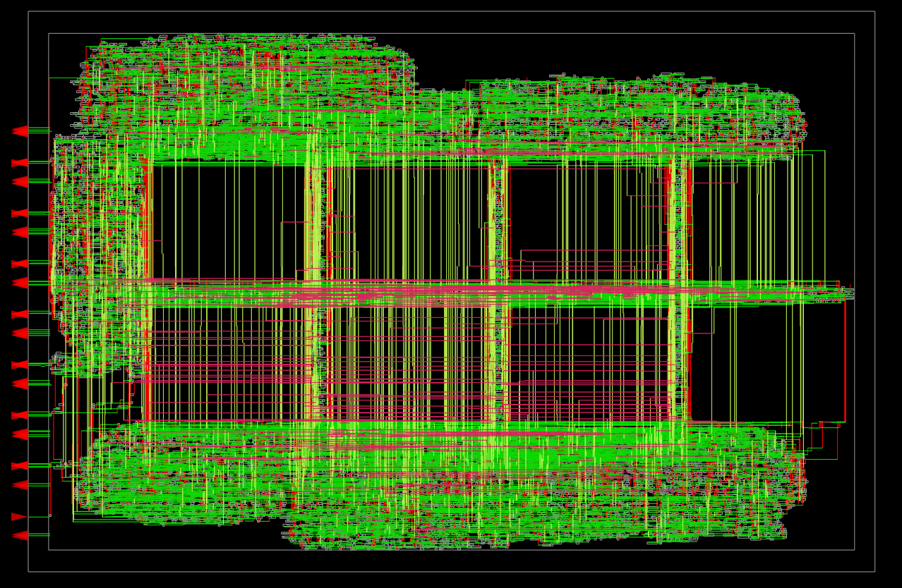
Layout Render - Openroad
OpenROAD — signal nets only. Datapath + control routing (green/red/pink by layer) concentrated over the clustered macros and the mid‑channel — the traffic that the clustering keeps short.
† Block IR-drop computed by OpenROAD PSM on the power-connected design (RCX + SPEF, ~125 mW): worst rail sag DVDD 54.8 mV / DVSS bounce 70.6 mV ⇒ ≤ 3.8% of 3.3 V, inside a typical 5% budget — the connector's via columns + M4/M5 core ring carry the load with margin. Full chip IR (through the shared padring) is an integration-stage analysis.
Signoff metrics
Worst DVDD drop | 54.8 mV (rail → 3.245 V)
Worst DVSS bounce | 70.6 mV
Average drop | 48.6 / 62.1 mV (DVDD/DVSS)
Power‑grid violations | 0 · connectivity verified

Slide 7
How the die is built
Parameter | Value | Notes
Die / Core | 1675 × 1110 µm 1,642,850 µm² core | ACV project block (1.859 mm²). ~40 µm die-to-core margin holds the PDN core ring.
Macros | 8 × sram256x8m8wm1 301.30 × 224.93 µm ea. | Clustered 4×2 grid. x = 244.9 / 601.2 / 957.5 / 1313.8; y = 297.57 (A row) / 577.5 (B row). 55 µm channels, N orientation. Shifted +130 µm east to open a ~245 µm west channel for the serial bridge + west-edge I/O.
C buffer | flip‑flops | 16 × 24‑bit registers + 1‑cycle registered read. Removes the 9th macro; the register bank places freely in the fabric.
Target density | 50 % → 53.9 % achieved | Antenna closed by the GRT diode-margin sweep (slide 11). Clustering shortens the broadcast nets; density 50 is the placement that routes them all clean.
Instances | 83,862 total | 33,315 std cells · 11,344 antenna diodes · 8 macros · balance = fill/tap/decap/endcap.
PDN | Metal4 ∥ + Metal5 ⟂ straps | Single 3.3 V DVDD/DVSS grid, 5 µm straps @ 75 µm pitch. Macro pins connect on Metal3 (OCD SRAM tops out at Metal3 — custom pdn_cfg.tcl). + a Metal4/Metal5 core ring in the 40 µm margin; the padframe's Metal2 DVDD/DVSS pins weld to it via connect_power_v4.py.
Ports | 11 ACV pad terminals | 9 signals (clk, rst_n, SCLK, MOSI, CS_N, MISO, busy, done, wb_done) + DVDD/DVSS on the WEST edge (W12–W22); the 53-bit DLA bus is wrapped behind a 4-wire serial bridge (62 pad-control ports).

Slide 8
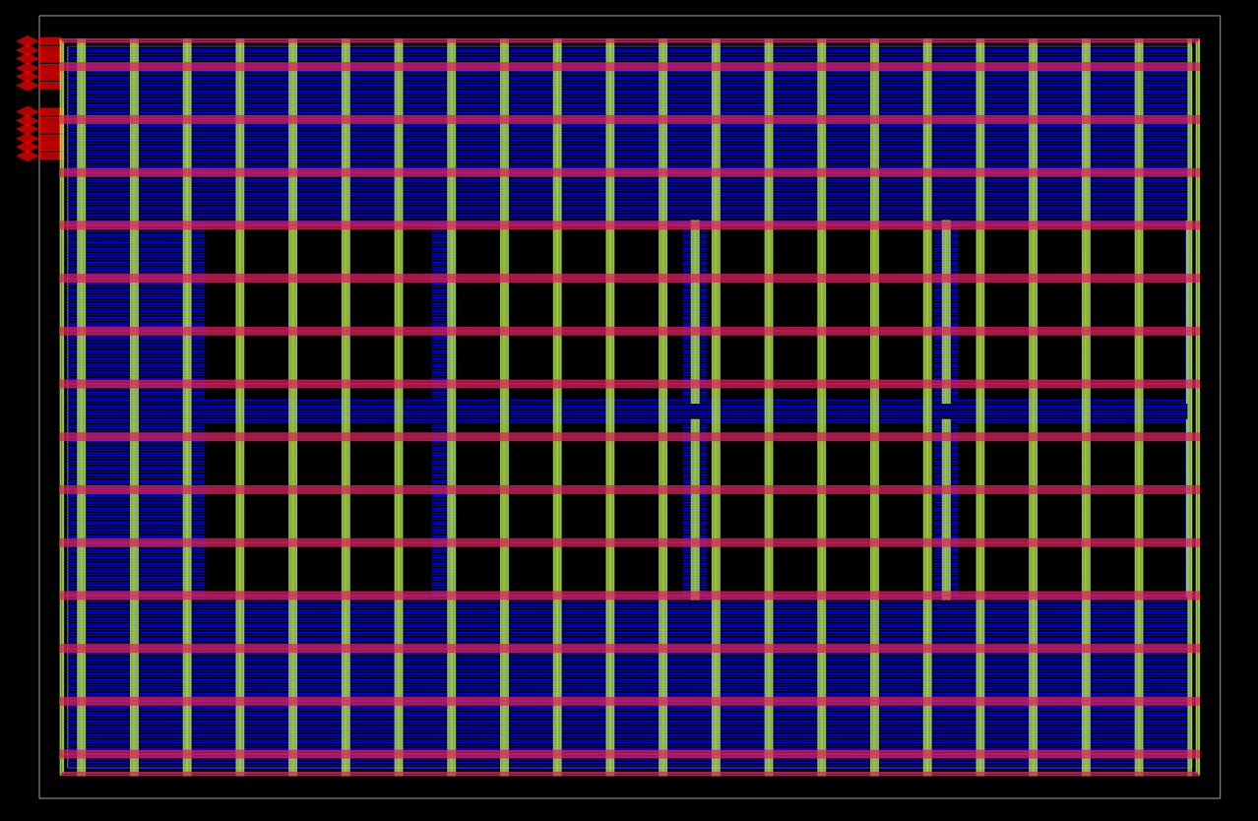
Power delivery network
OpenROAD — power nets only. Vertical green = Metal4 DVDD/DVSS straps (5 µm @ 75 µm pitch); horizontal blue = per‑row Metal1 rails. The dark rectangles are the 8 macros (fed on Metal3); green diamonds are the power pins.
Single 3.3 V domain (DVDD/DVSS) — no domain crossings, no level shifting. Running DVDD/DVSS as closely‑spaced interleaved straps is intentional: it lowers PDN loop inductance and adds decoupling capacitance.
Both SRAM banks tied to the grid explicitly on Metal3 via PDN_MACRO_CONNECTIONS; well/substrate taps in every AS std cell + macro (DRC‑enforced spacing).
IR‑drop & EM low: 125 mW at 25 MHz with min‑drive cells; straps sized far above demand. A Metal4/Metal5 core ring in the die-edge margin carries DVDD/DVSS; connect_power_v4.py welds the padframe's Metal2 template pins to it (DRC/LVS-clean).

Slide 9
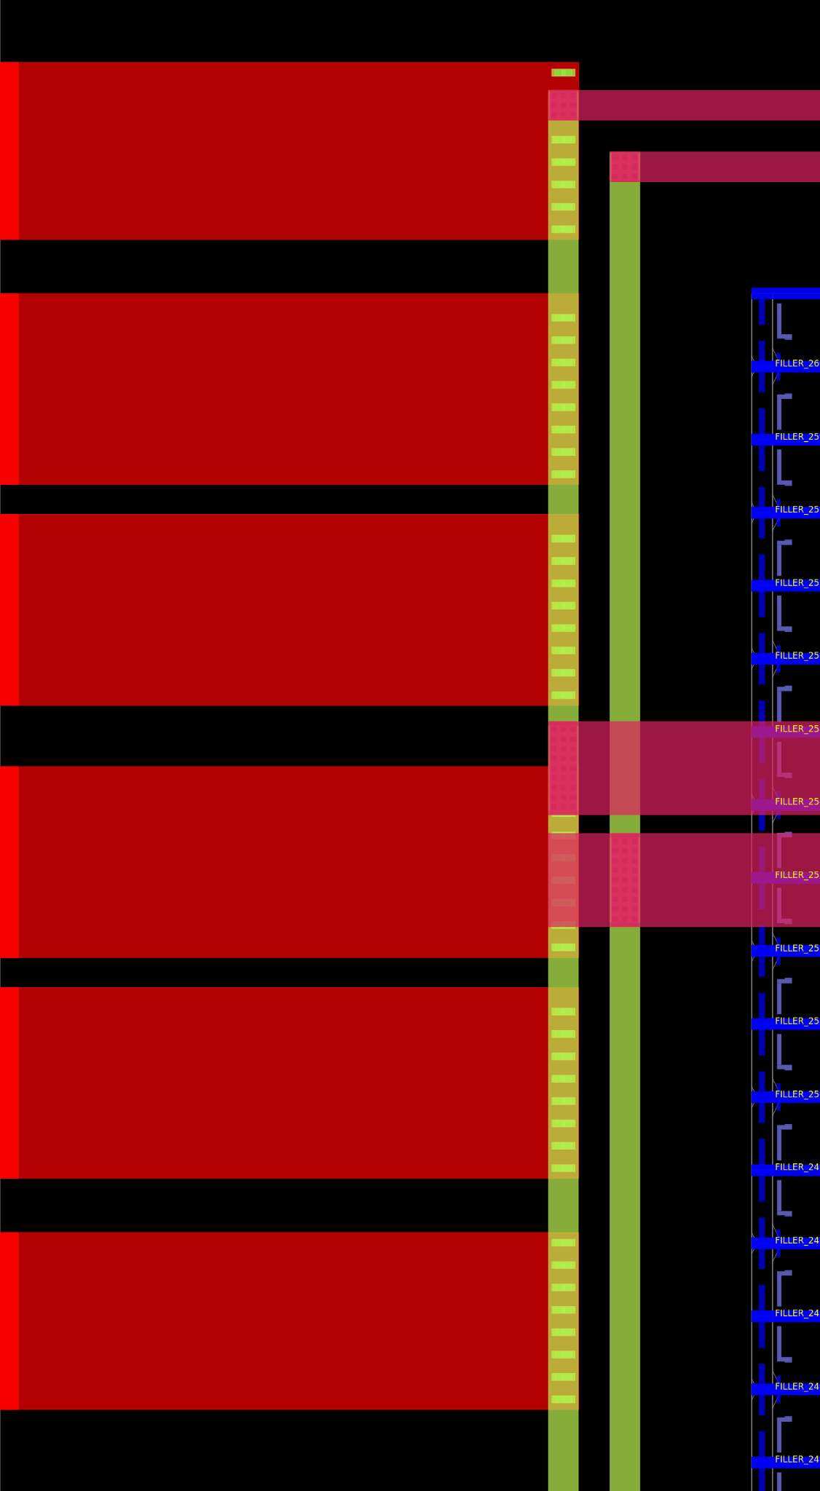
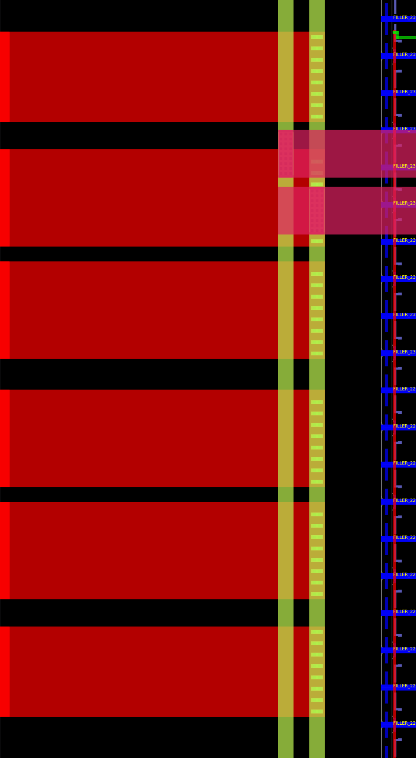
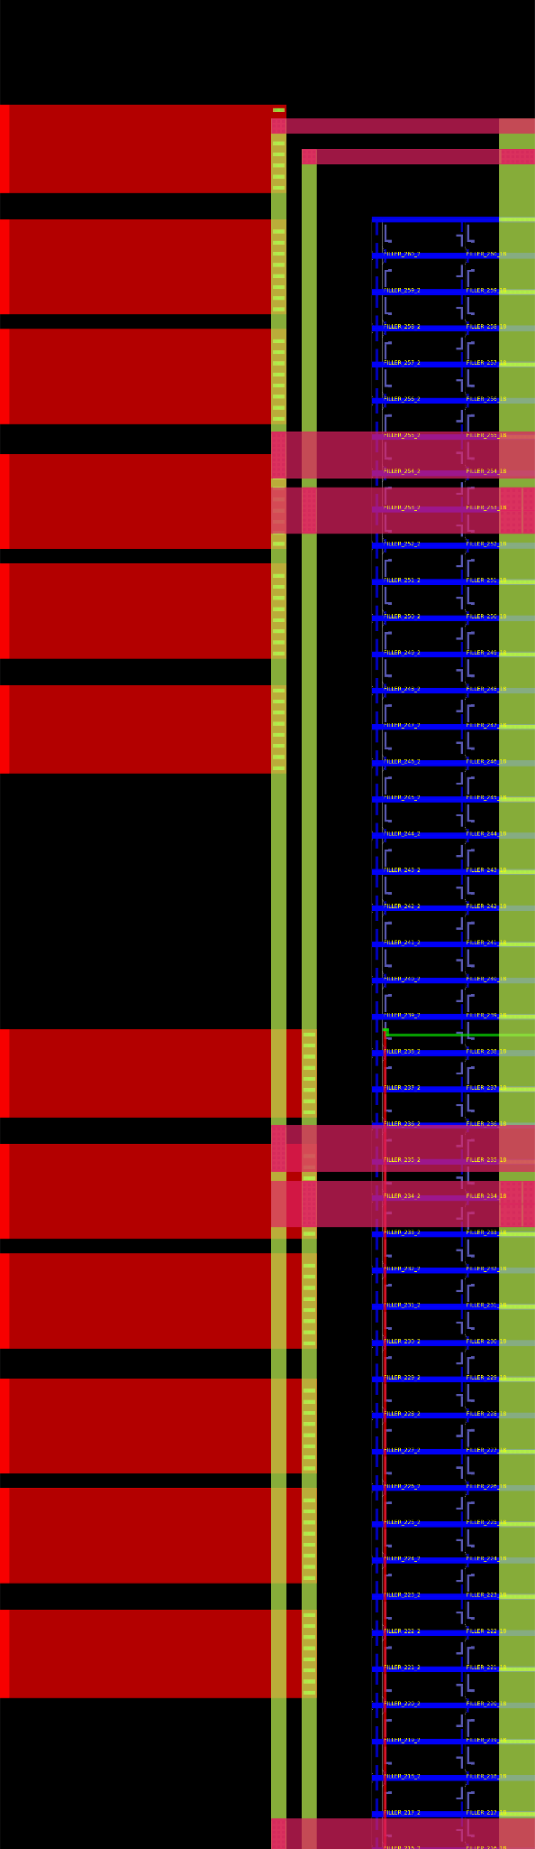
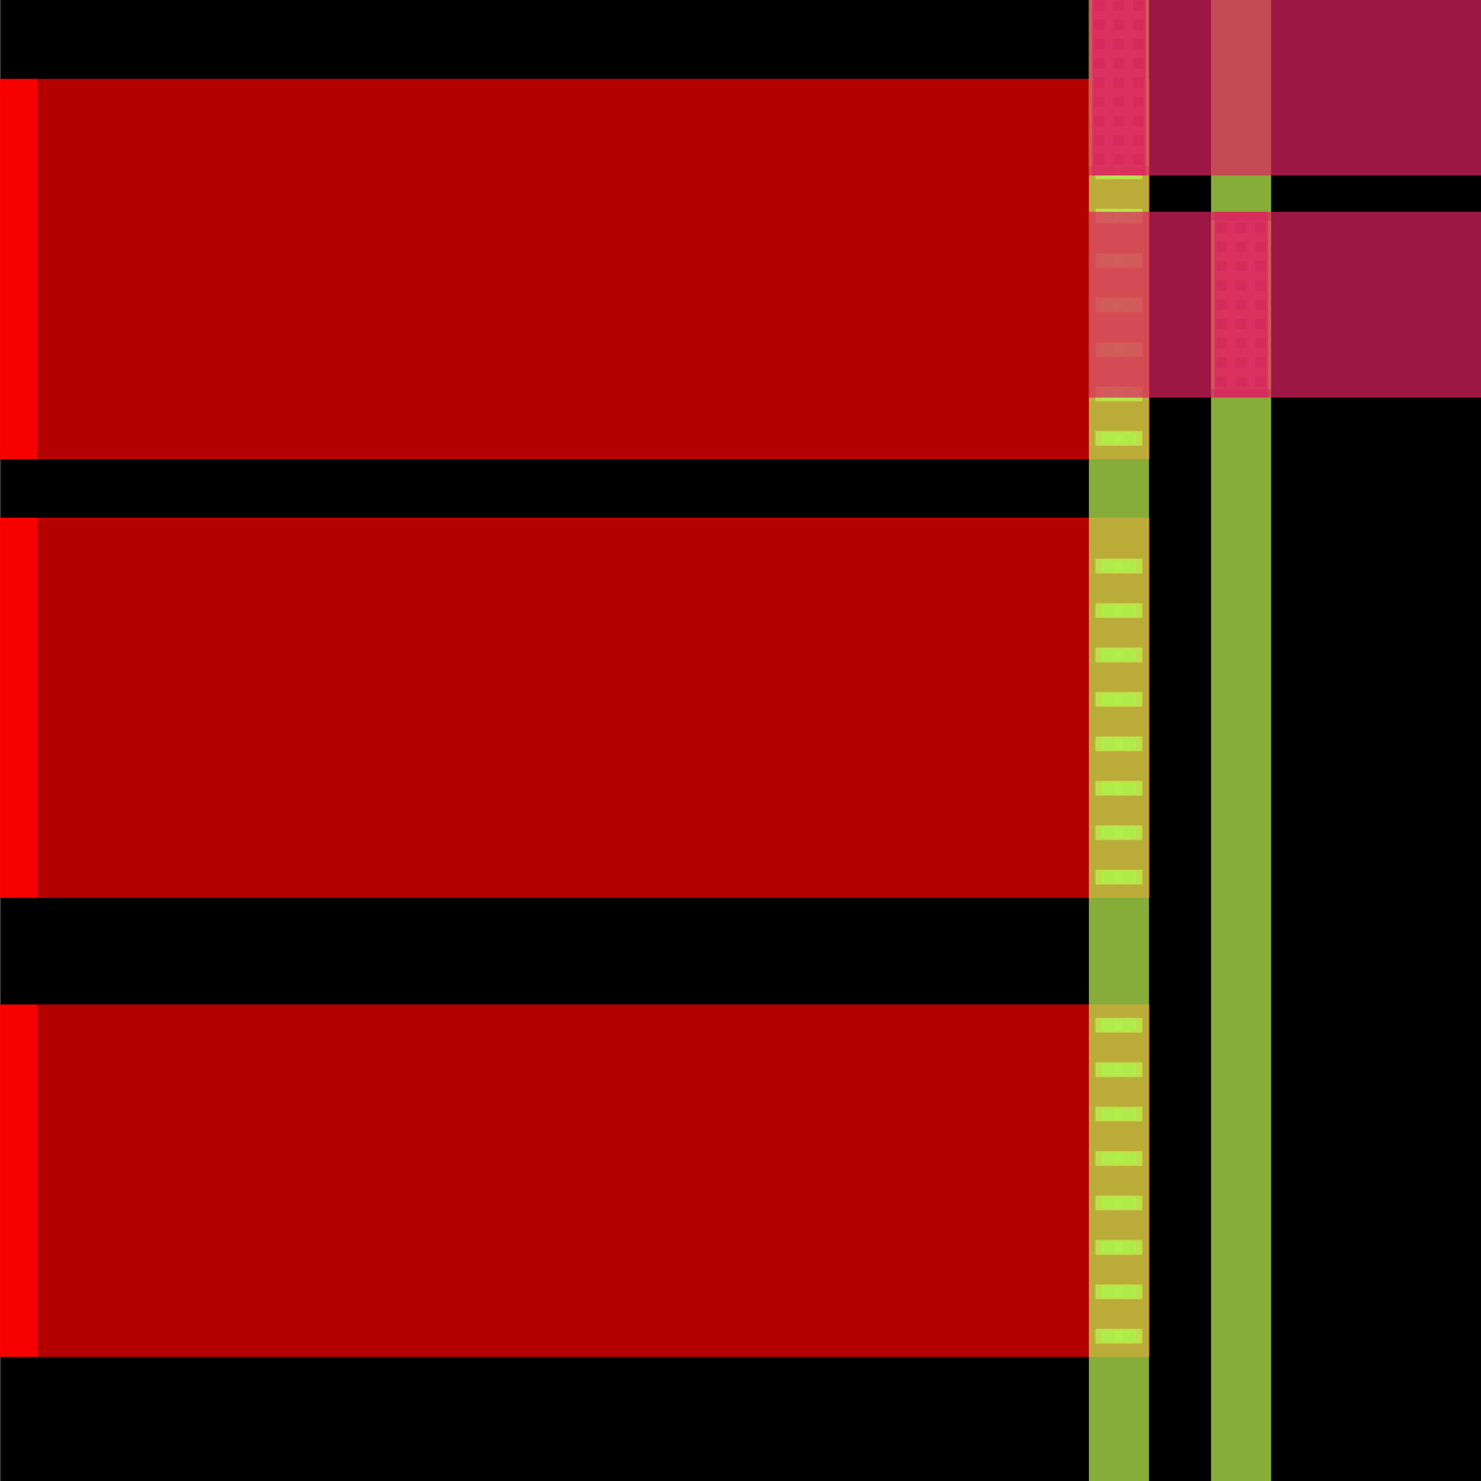
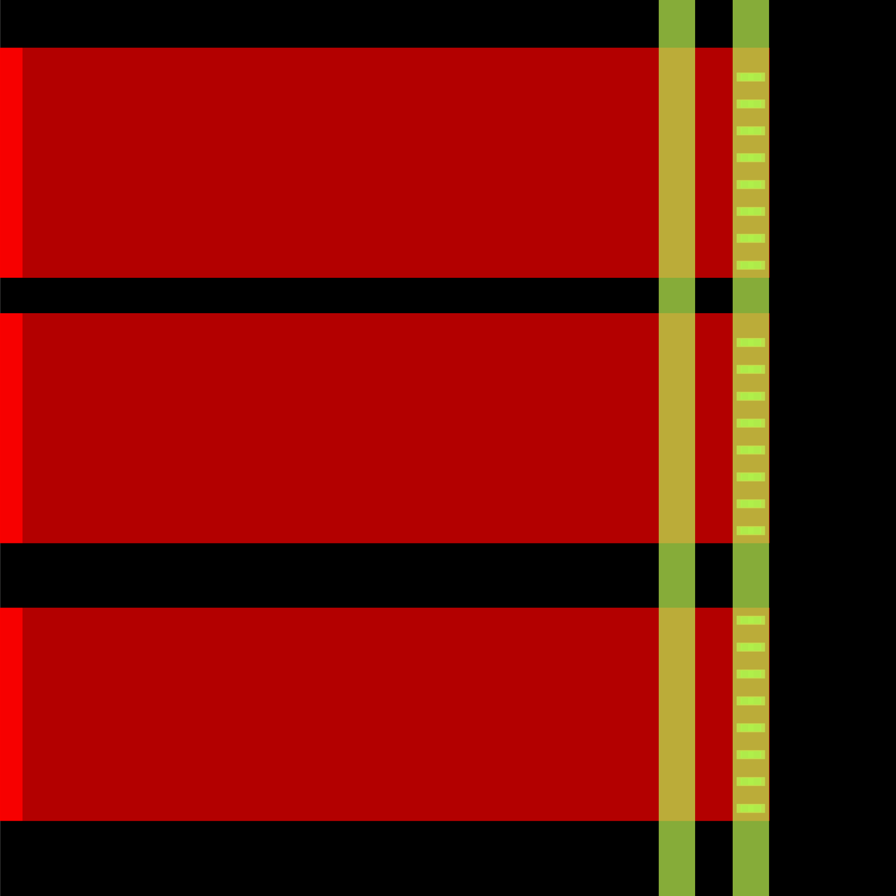
Power delivery network - DEF template connection
Power Pin Connection
DVSS
DVDD
connect_power_v4.py welds each padframe Metal2 DVDD/DVSS pin (west edge) to the core ring — a Metal2 reach + a via column per finger. DRC/LVS-clean, no connect-by-label.
DVSS Zoomed
DVDD Zoomed

Slide 10
Remaining Review Criteria
Analog / Matching
Fully digital — no analog circuitry. No PLL, no matched pairs, no sensitive nodes. The only analog‑adjacent structures are the SRAM sense amps, pre‑qualified foundry IP used as‑is.
Top‑Level Integration
Top cell dla_engine_chip everywhere (RTL ⟷ netlist ⟷ layout).
Pin names match RTL 1:1 — proven end‑to‑end by LVS.
Ports = pad-control terminals at the template positions; DVDD/DVSS welded to the core ring by connect_power_v4.py.
Hardened against the auditor's A56_ACV.def padframe template; presents the 11 ACV pad terminals on the west edge.
Reliability & PD Risk
Antenna: 0 violations — closed to literal zero (slide 11); no residual charge‑accumulation risk.
Latch‑up: taps in every std cell + macro, DRC‑enforced spacing.
Voltage: single 3.3 V, all AS cells + OCD SRAM 3.3 V‑rated.
EM / current density: negligible at 25 MHz, min‑drive cells.
ESD: pad-level clamps live in the auditor's padframe (pad cells are outside this project block).
Rubric 1 recap (DRC/LVS): Magic DRC 0, routing DRC 0, GDS XOR 0; Netgen LVS matches uniquely across 25,342 devices — layout corresponds to the RTL device‑for‑device. Full signoff on slide 2.

Slide 11
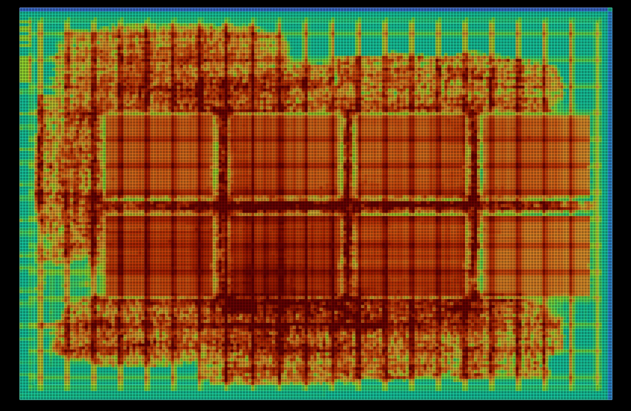
Antenna closure: 4 → 2 → 0
Experiment | Antenna | Note
clustered 4×2 baseline | low | clustering keeps the SRAM broadcast nets short (from longtin)
new west-edge template · margin 25 | 5 | auditor moved every pin 100 µm → routing re-rolled (was 1)
GRT diode margin 50 | 3 | cleared 2 of the 3 marginals
GRT diode margin 75 | 0 ✅ | winner — cleared net5, the structural buffer→output net
Lesson: the clustered macros keep the base count low, but the auditor's new pin template re-rolled routing to 5 nets. Because the pin positions are auditor-fixed and can't be moved, a more aggressive global-route diode margin (25→75) is more targeted than a density re-roll — it cleared even net5, the one structurally-long net that recurs every harden. DRC/LVS stayed clean.
OpenROAD — placement‑density heatmap. Red = packed, teal = sparse. The datapath logic packs tightly around the clustered macros (the placer pulls connected cells to the memories), with routable breathing room at the perimeter — exactly the compact arrangement that keeps the broadcast nets short.

Slide 12
UVM environment (pyuvm on cocotb)
UVM (IEEE 1800.2) builds a testbench from cooperating components that speak in transactions, not wires. Here it runs in Python via pyuvm (a faithful port of the standard classes) driving the DUT through Icarus — every class name is identical to SystemVerilog UVM.
Mapped to the accelerator
DlaOp = one matmul job (A 4×256 weights, B 256×4 inputs).
Sequence = 1 directed (A=B=1 ⇒ every C=256) + 3 constrained‑random ops.
Driver = real protocol: stream A/B, pulse start, wait wb_done, read 16 C.
Monitor = reconstructs the 16 C outputs from the read‑back bus.
Scoreboard = predicts C=A·B (INT8, 24‑bit wrap) and compares.
Scope: this env black-box-verifies the DLA core (dla_engine_top), instantiated unchanged inside the submitted dla_engine_chip. The bridge-wrapped chip is additionally directed-tested at the ACV pads (tb/dla_engine_chip_tb.sv), bit-exact against the same goldens.
DlaTest (uvm_test) — builds env, starts sequence, checks tally
DlaEnv (uvm_env) — wires analysis ports
DlaAgent (uvm_agent)
├ Sequencer — routes DlaOp items
├ Driver — the only pin‑wiggler
└ Monitor — passive; rebuilds C from pins
DlaScoreboard
golden matmul + checker
# cd /foss/designs/tb/uvm && make
[directed_ones] PASS: 16/16 match (C[0][0]=256)
[rand_0] PASS [rand_1] PASS [rand_2] PASS
ALL 4 TRANSACTIONS PASSED — 4 passed, 0 failed
Sequence → Sequencer → Driver →(pins)→ DUT
DUT →(pins)→ Monitor →(observed C)→ Scoreboard
Driver →(applied A,B)──────────────→ Scoreboard

Slide 13
Notes for the reviewer
Why C moved to flip‑flops
C holds only 16 accumulators (48 bytes) — a wasteful 64×8 macro. As flip‑flops it costs ~408 registers (tiny in an 85k‑instance die), removes a macro, cuts writeback 48→16 cycles, and drops the C read latency 4–5→1 cycle. A/B stay SRAM because they need four parallel 8‑bit lanes each.
Post-layout timing — no SDF simulation: the 3.3 V AS standard-cell library ships with no `specify` timing blocks (0 across 78 cell models), so SDF-annotated dynamic gate-level sim isn't possible in this open toolset. Post-layout timing is signed off by SPEF-backed 9-corner STA (the standard method) and functional equivalence by zero-delay GLS. The open PDK's 5 V library does carry specify (916 blocks) — so it's a library, not a toolset, limitation.
Why cluster the macros
A roomy die spreads the memories apart, so the SRAM→PE broadcast nets route long and trip antennas. Pulling the 8 macros into a compact central block (55 µm channels) shortens those nets at the source; a density sweep then finds the placement (d50) that routes the residue clean. Result: antenna 0, timing/DRC/LVS unchanged.
Opening this design in OpenROAD
# interactive GUI (needs a display) — pan/zoom, toggle layers & the PDN, inspect timing
openroad -gui runs/acv_ring4/final/odb/dla_engine_chip.odb
# in the GUI: Nets ▸ turn off Signal to get the Power/Ground view (slide 5)
# headless screenshot (full die), for the design views:
QT_QPA_PLATFORM=offscreen openroad -exit _or_render.tcl
# read_db .../final/odb/dla_engine_chip.odb ; save_image -area {0 0 1675 1110} out.png
# the raw GDS stream is a KLayout job (OpenROAD has no GDS reader):
klayout runs/acv_ring4/final/gds/dla_engine_chip.gds

